Slide 1

ELECTROCAP
Mid - Program Pitch Deck
Smart Home Stock (SHS)

Slide 2
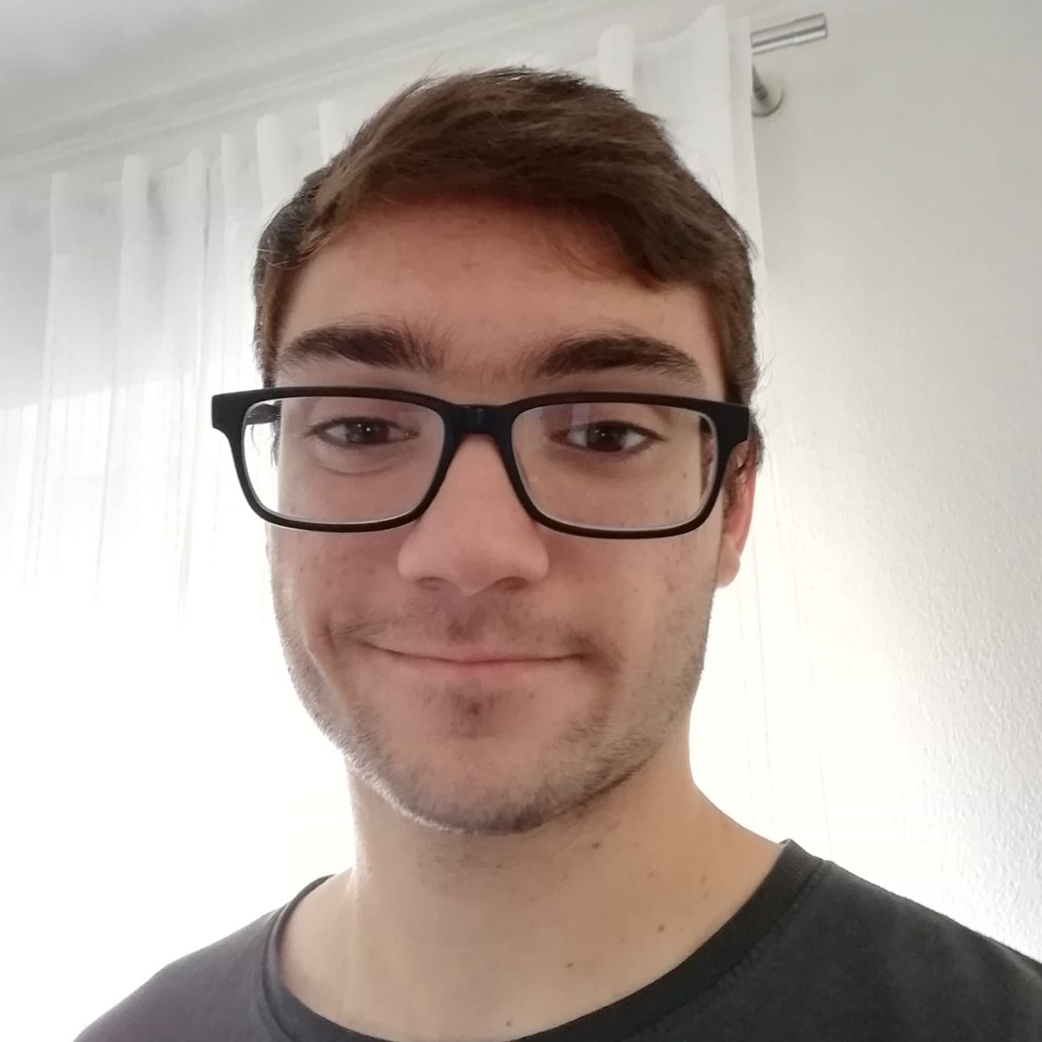
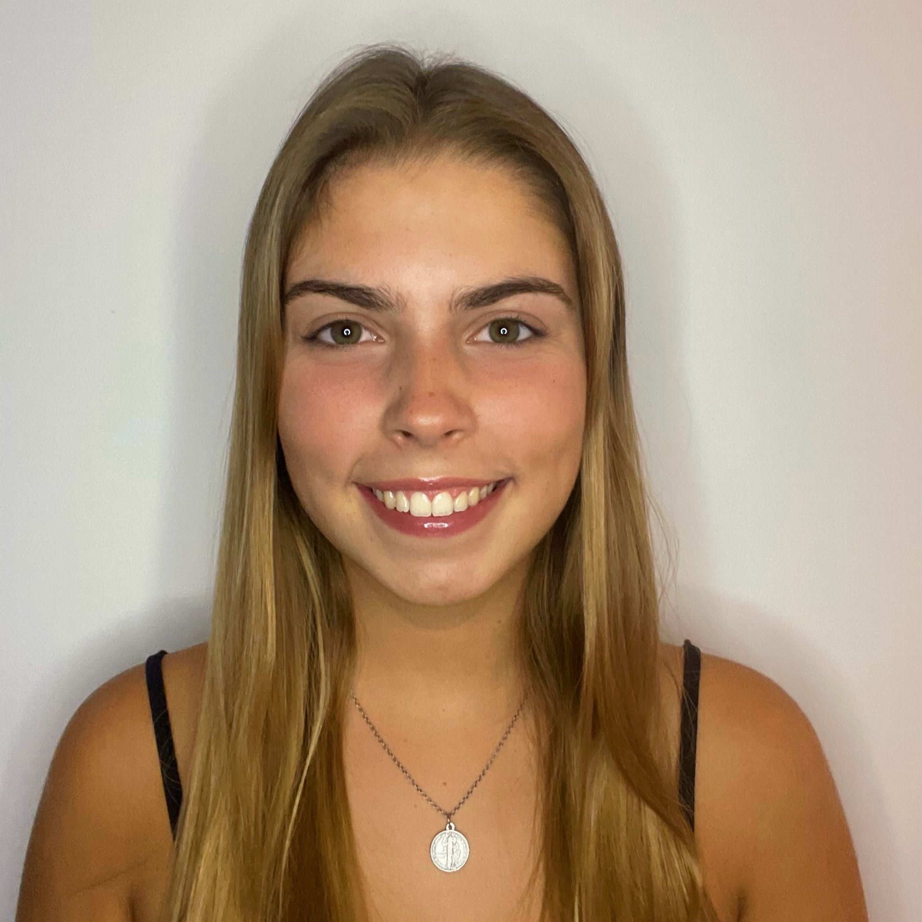
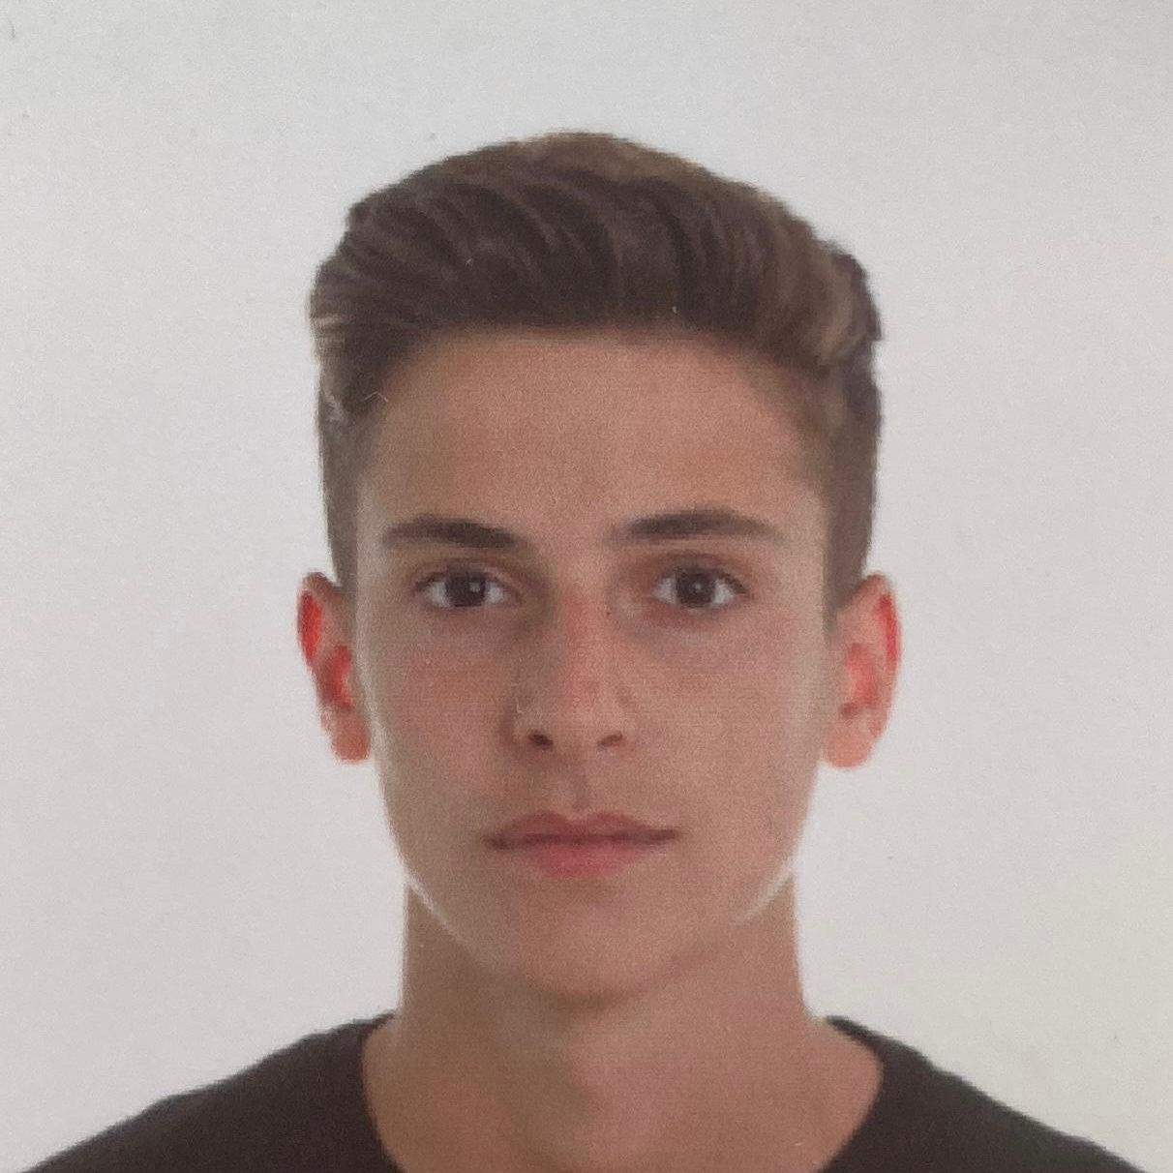
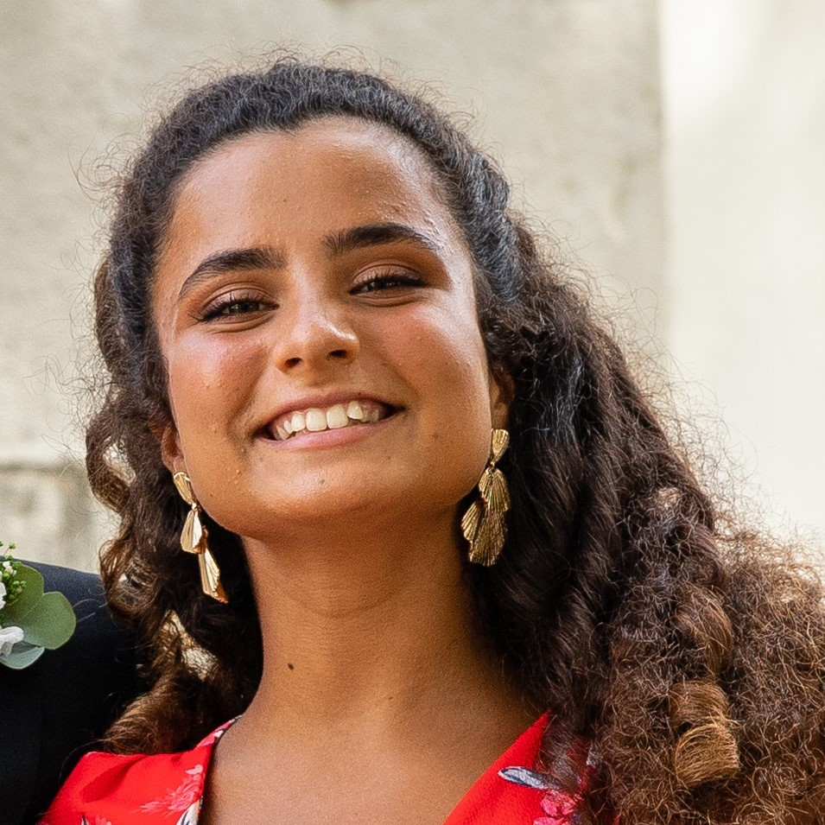
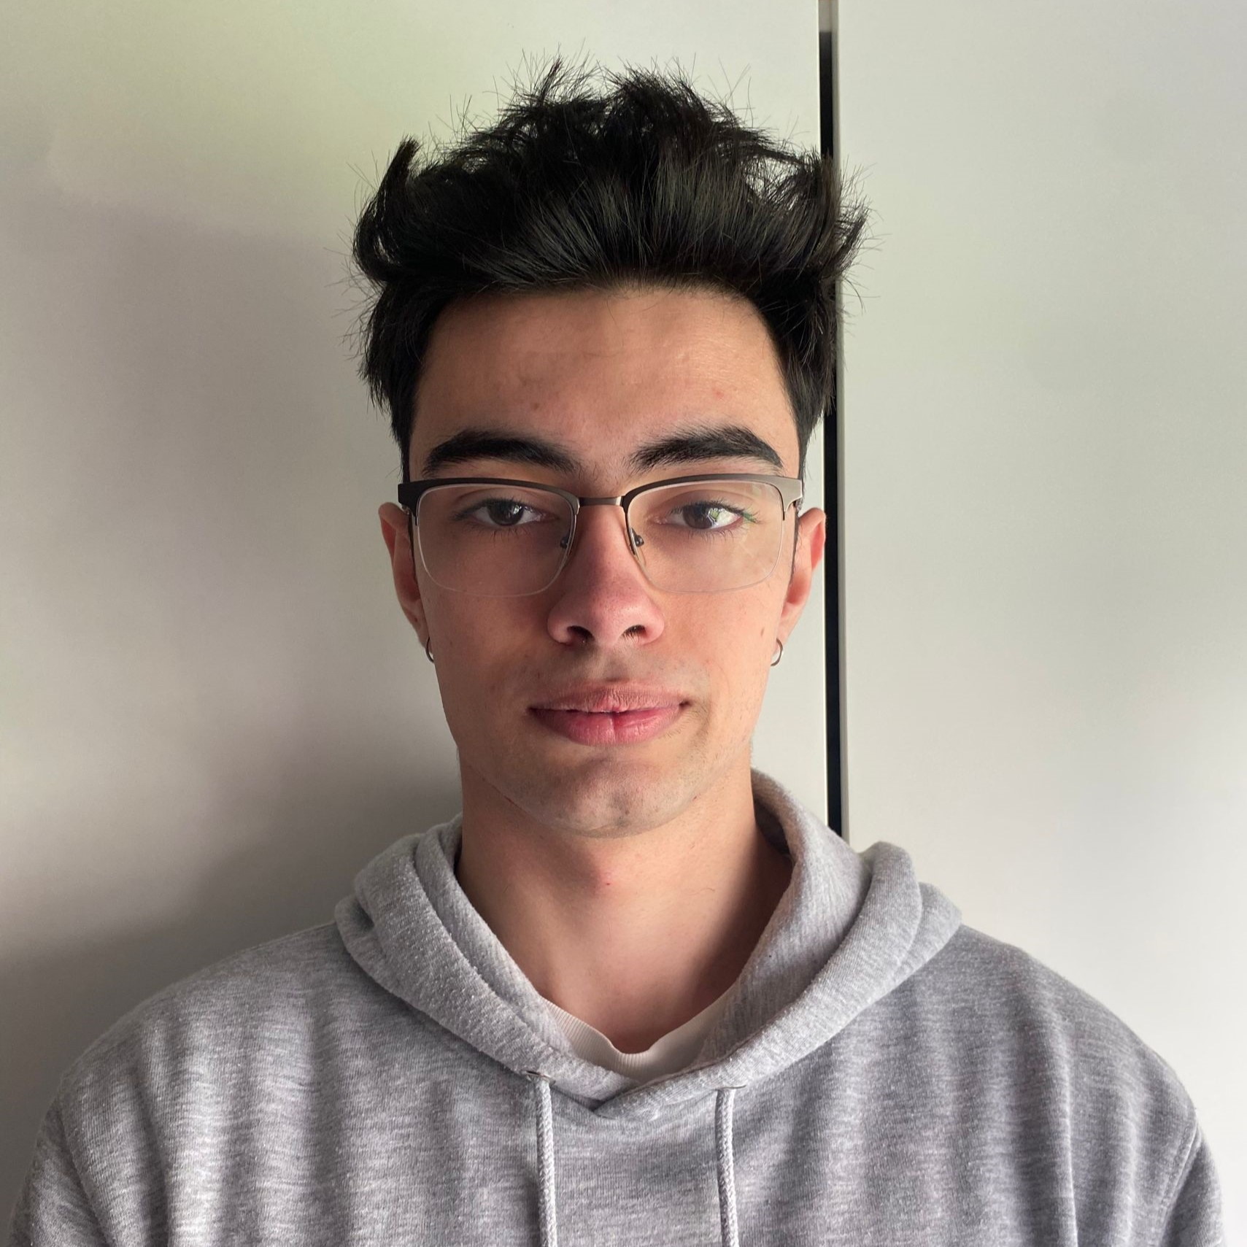
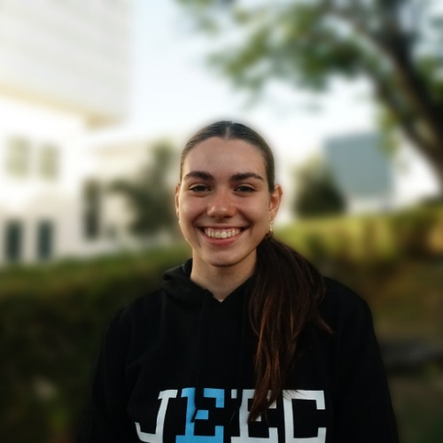
Team members
Renato Simões
Prototype Designer
Vera Amaral
Website Designer and Manager
Henrique Simões
Software Engineer
Leonor Mira
Image/Video Designer
Ricardo Fiúza (Leader)
Hardware Engineer
Rafaela Pereira (Co-leader)
Communication App-Prototype

Slide 3



Advisors and Mentors
António Grilo
Scientific advisor
Teresa Vazão
Coordinator
Ricardo Santos
Mentor

Slide 4

PROBLEM DEFINITION

Slide 5
Problem definition
Not knowing efficiently and effectively, what kind of items (and their respective quantity) people have inside their homes.
Unnecessary purchases.
Items running out unexpectedly.
Unnecessary food waste.

Slide 6

Solution beneficiaries

Slide 7


Solution beneficiaries
Environment
Household member and Grocery Shopper
Improved organization and awareness of available food supplies.
Streamlined shopping experience with a more accurate and personalized shopping list.
Reduction in food waste contributes to environmental sustainability.
1

Slide 8

Technological solution

Slide 9
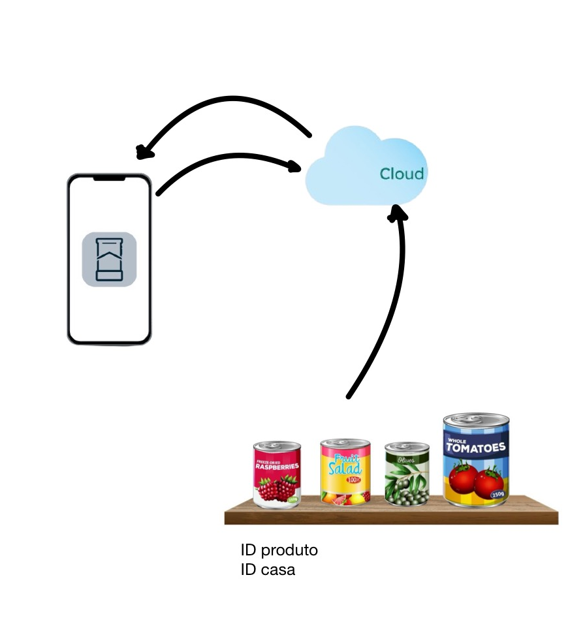
Technological solution
Hardware: determines which products and respective quantities are in stock.
Cloud Server (Database): Receives and stores every product information.
Mobile App: user’s interface.
Displays stock items and their quantities.
Warns of low quantity of a certain item.
Automatic Shopping List.
Average used food per meal.

Slide 10

Solution requirements

Slide 11
Solution requirements
Must be able to accurately monitor the quantity of each stored food item.
Use of weight sensors and camera to determine the amount of food consumed in each meal.
Should integrate with a mobile app.
The client needs to provide the measurements of their pantry shelves so that the scale can be custom-made

Slide 12

Competitors & previous work

Slide 13
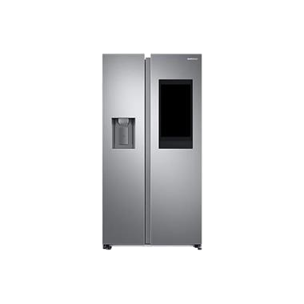

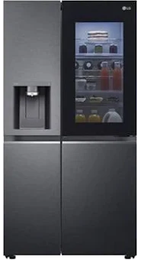




Competitors and previous work

Slide 14
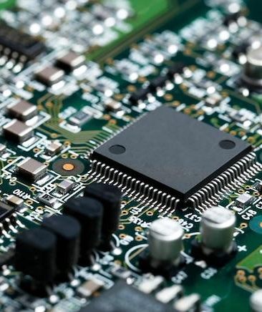
TECHNICAL CHALLENGES

Slide 15
Technical Challenges
Sensors accurately measuring and the estimation of quantity of food items used in each meal.
Safeguarding user data stored specially sensitive information.
Allowing identification of food.
Ensuring stable and reliable communication between hardware and the mobile app.
Creating an intuitive and user-friendly app interface to encourage consistent usage.
Algorithms that estimate the quantity of food used per meal.

Slide 16

PARTNERS

Slide 17
PARTNERS
As of today, the Smart Home Stock (SHS) team, doesn't have any partnership

Slide 18

TESTING AND VALIDATION METRIC

Slide 19
Testing and Validation Metrics
To test and validate our idea, we decided to create a form. With the more than 400 responses, we realized the problem we are trying to solve indeed exists, and furthermore, we obtained some ideas that we could implement into our system.

Slide 20
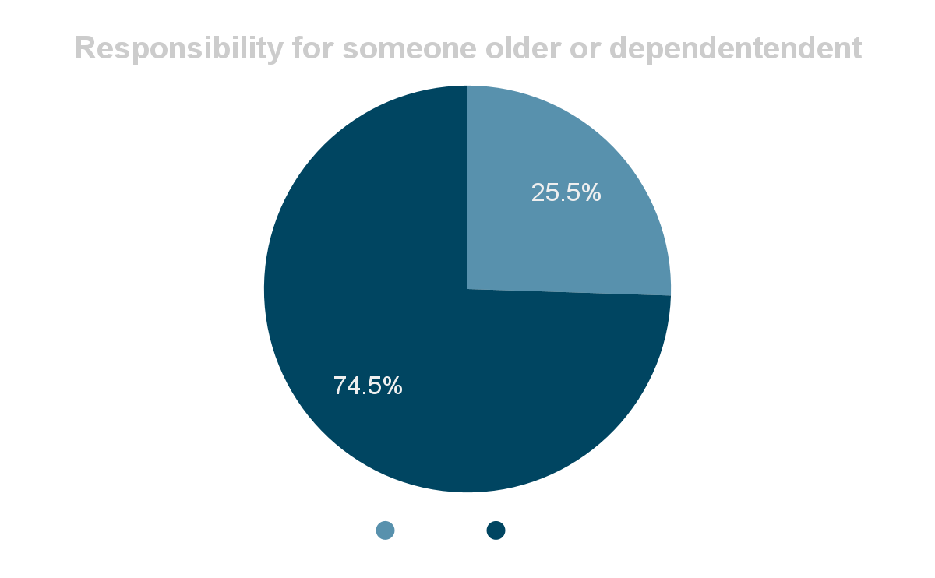
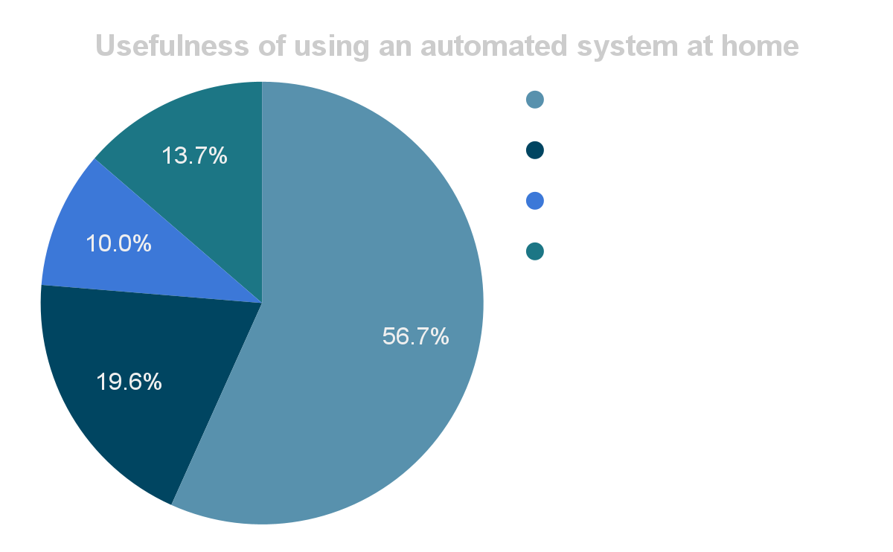
Testing and Validation Metrics
Data Analytics | Nº of answers: 439

Slide 21
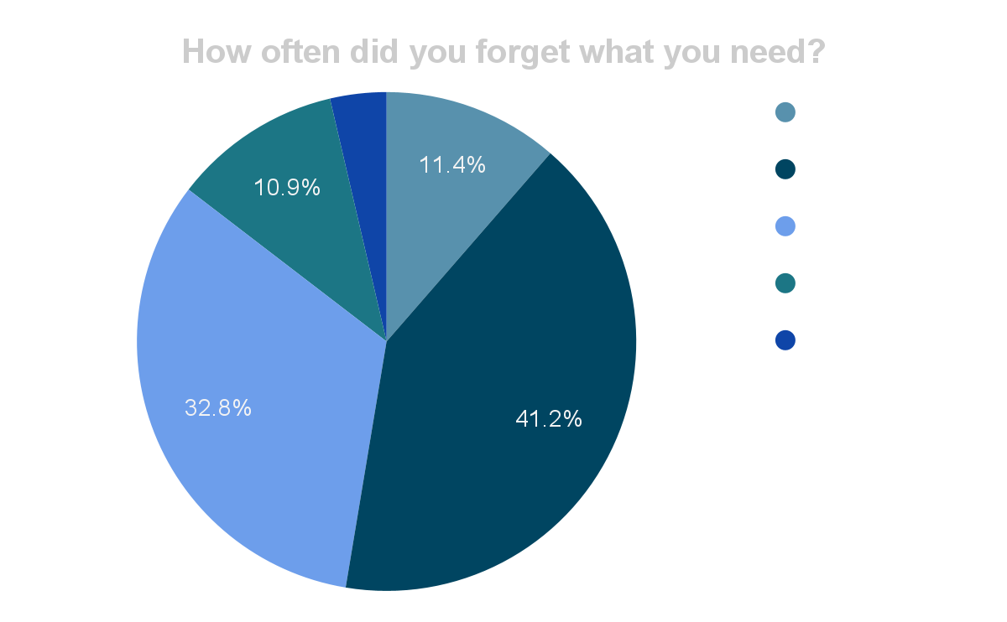
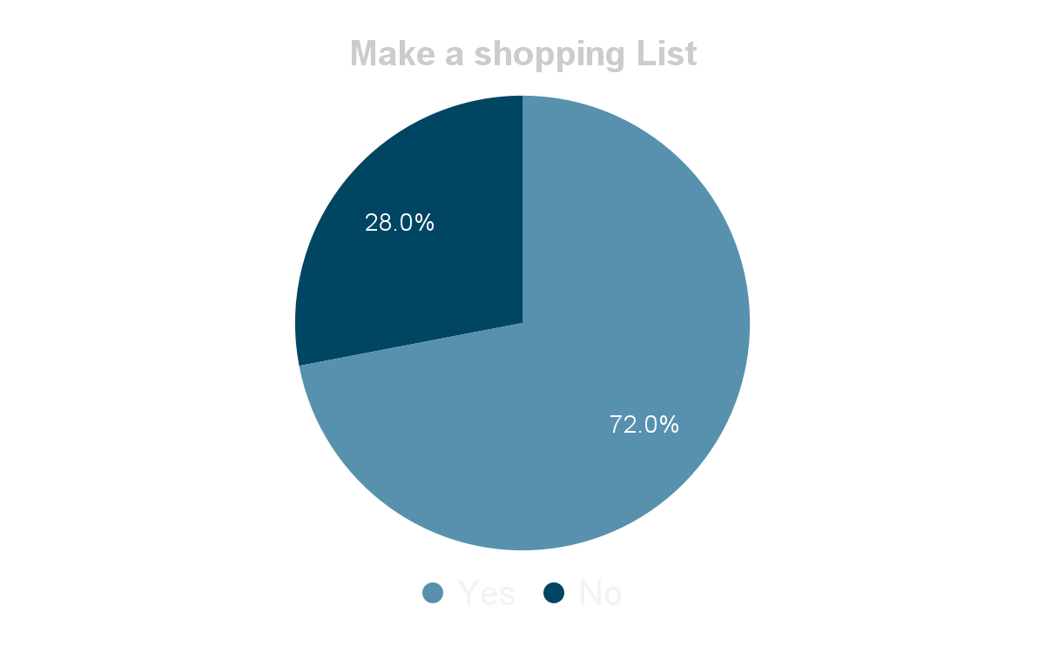
Testing and Validation Metrics
Data Analytics | Nº of answers: 439

Slide 22
Division of Labor
Prototype team
Ricardo Fiúza | Rafaela Pereira | Renato Simões
Search for Partners (Responsible) | Wireless communication between ESP32 CAM and Firebase (Responsible) | Object Identification with ESP32 CAM (Responsible)
Hardware Development and Management (Responsible) | Object Identification with ESP32 CAM | Wireless communication between ESP32 CAM and Firebase
Prototype Modelling | Prototype Modelling | Prototype Modelling (Responsible)

Slide 23
Division of Labor
Software and design team
Vera Amaral | Henrique Simões | Leonor Mira
Update Management (Responsible) | App Development and Management (Responsible) | Image Design (Responsible)
App Design | App communication with Firebase (Responsible) | App Design
App Development | Update Management | App Development

Slide 24
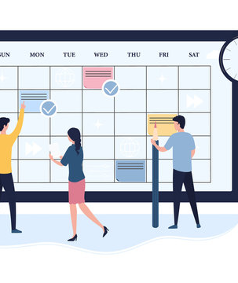
ORIGINAL SCHEDULE

Slide 25
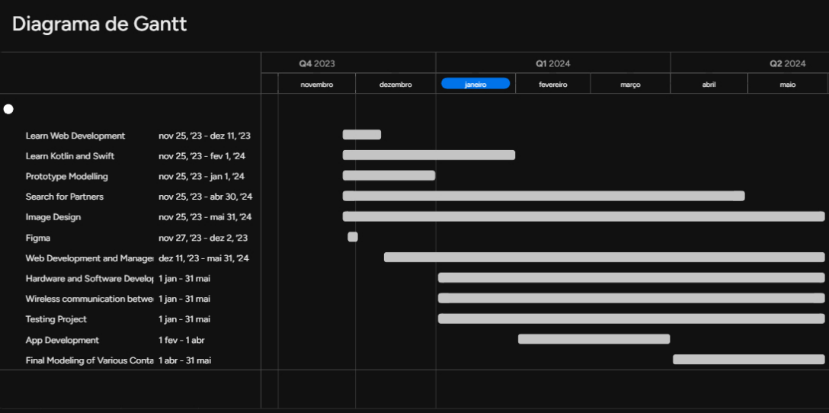
Original Schedule

Slide 26

MID-PROGRAM STATUS

Slide 27
Mid-program statuts
Replace the initial technology idea.
Instead of using a container/scale system for each product, we’ll use a set of larger scales, each occupying a shelf in the pantry, where various products would be placed on top of them.
Replace the previously planned load cell with a half bridge load cell.
Use an ESP32 with a camera to enable food recognition without the need for scanning.

Slide 28

ACHIEVED RESULTS

Slide 29
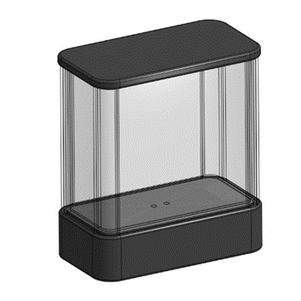
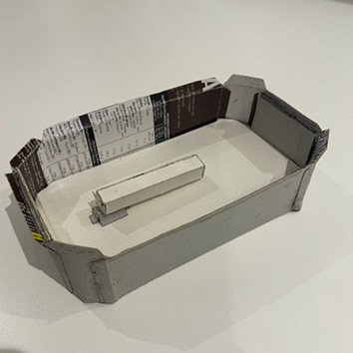
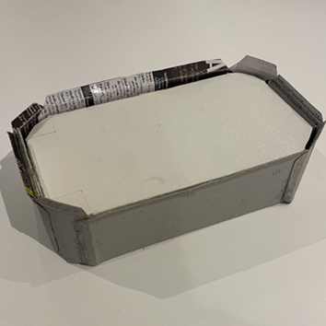
Achieved results
First Idea
Prototypes:
Interior of the base
Base with lid

Slide 30
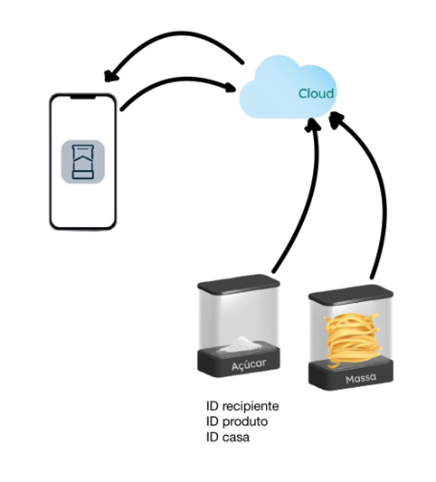
Achieved results
First Idea
Communication:
Material used for the product:
ESP32 Wroom NodeMcu Wifi CP2102
HX711
Load Cell (10kg)

Slide 31
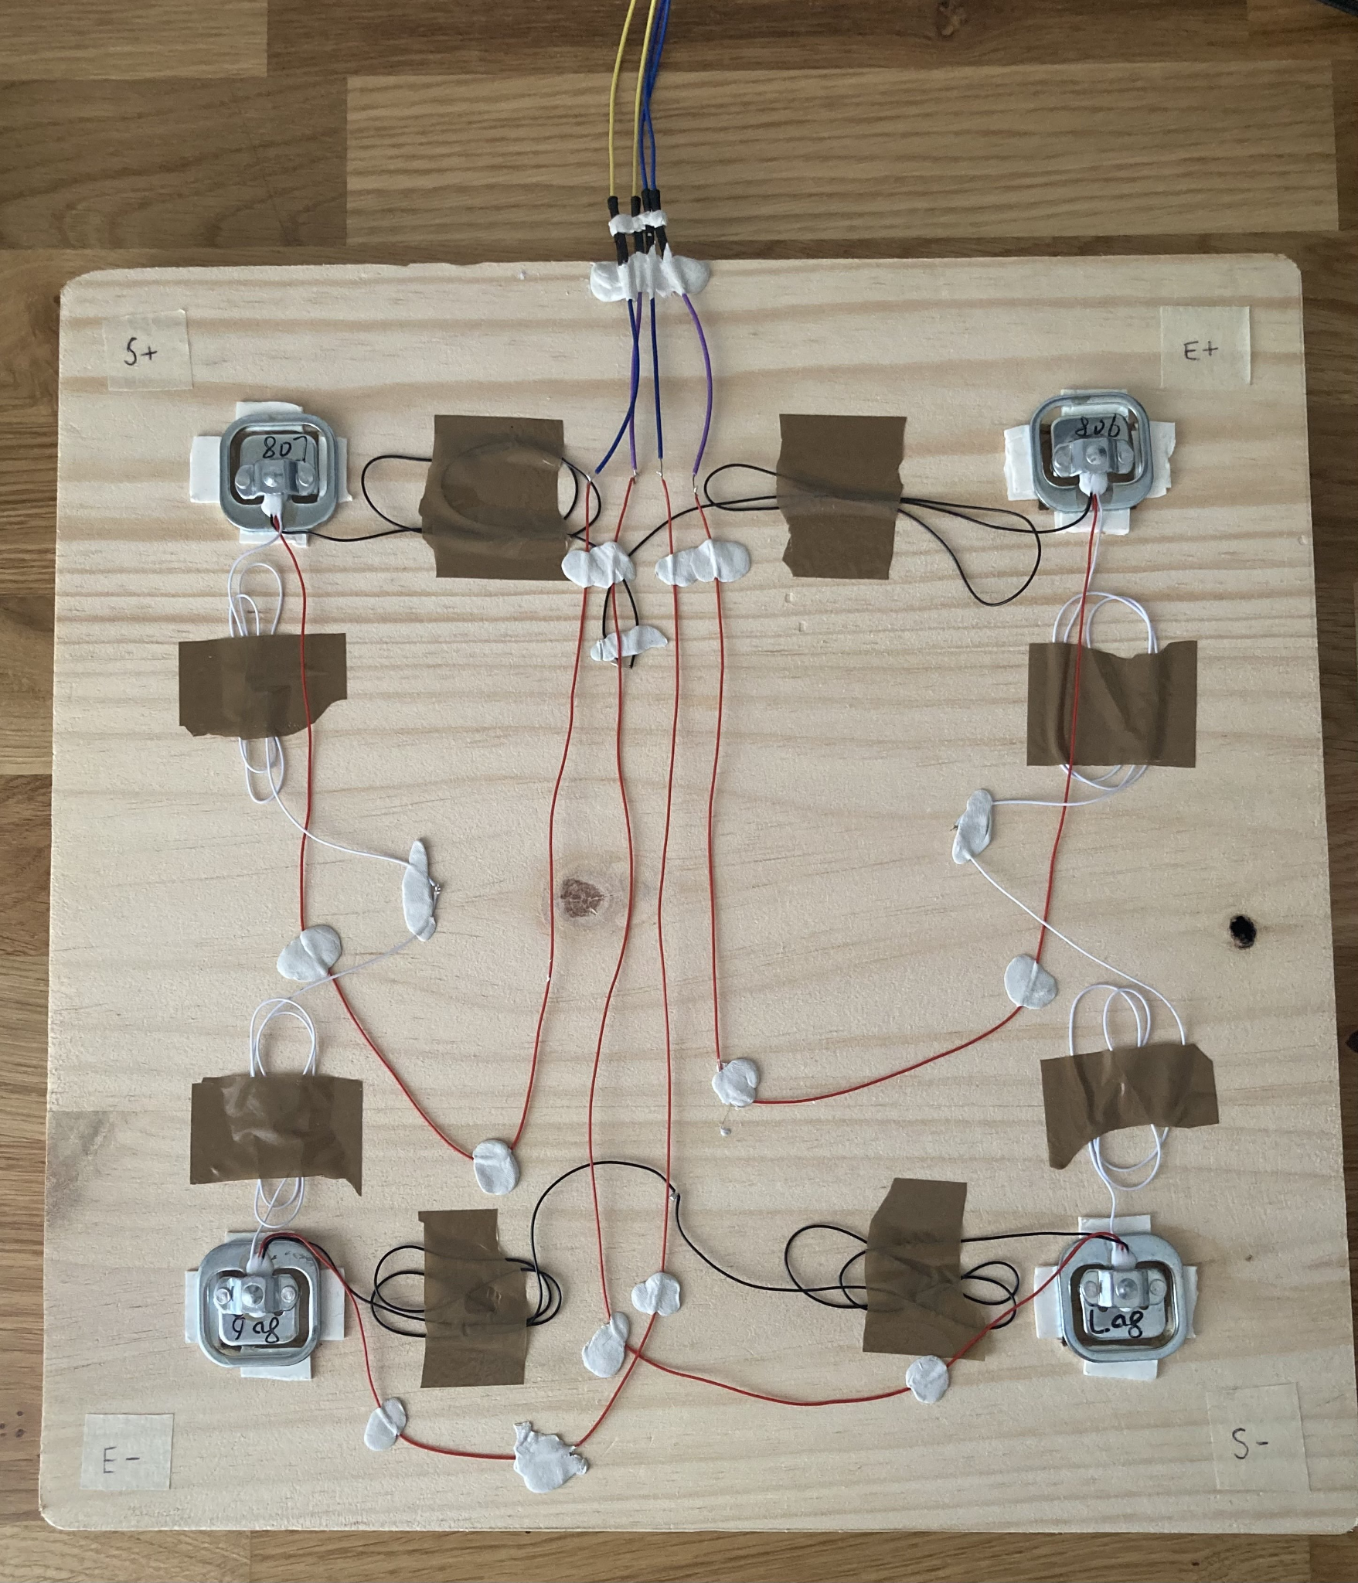
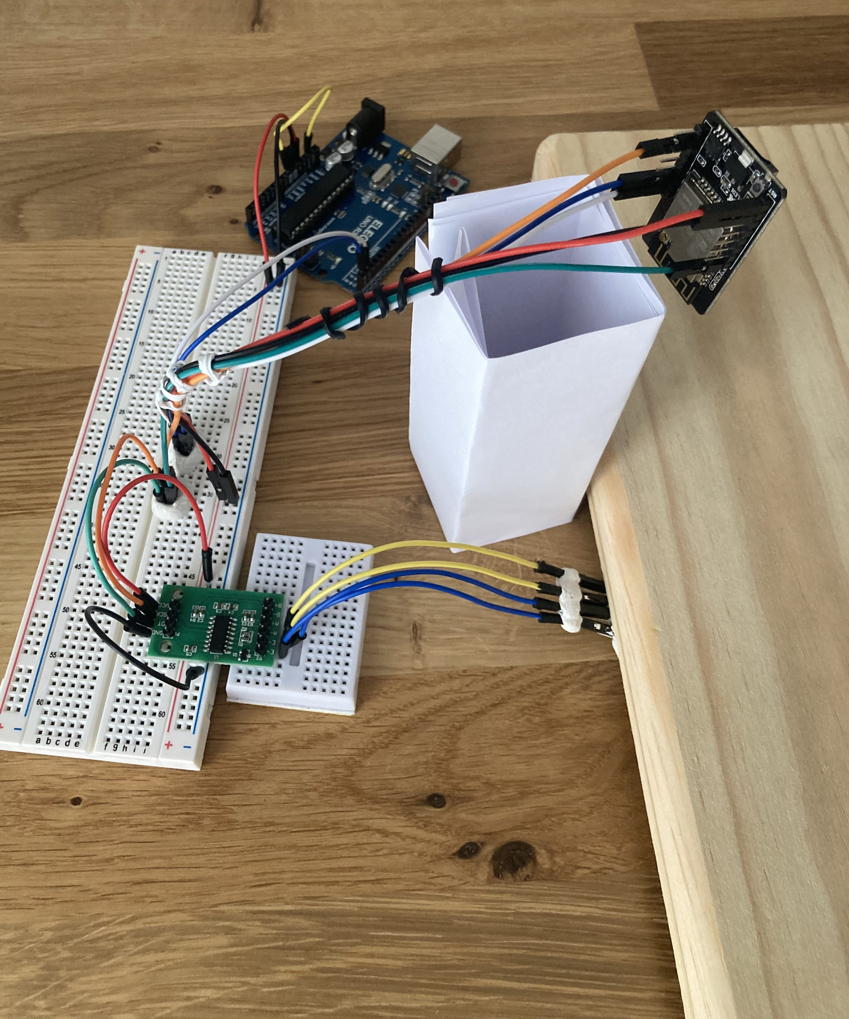
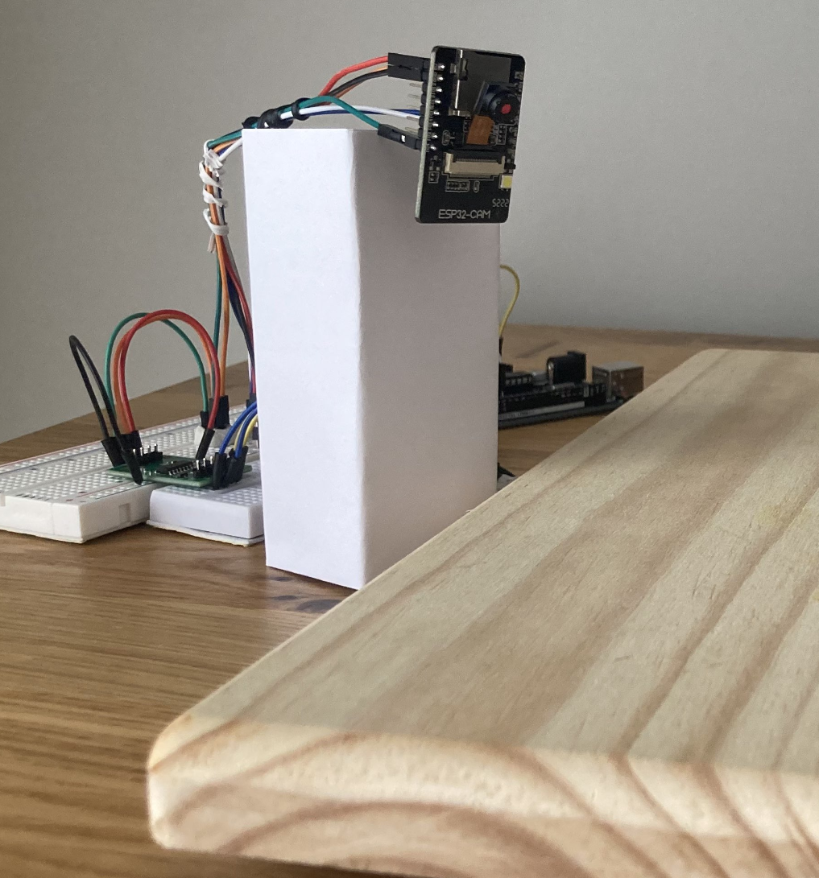
Achieved results
Second Idea
Prototypes:

Slide 32
Achieved results
Second Idea
Communication:
Material used for the product:
OV2640 - ESP32-CAM
HX711
Half Bridge Load Cell (50kg)
Wooden Board
Arduino UNO R3

Slide 33
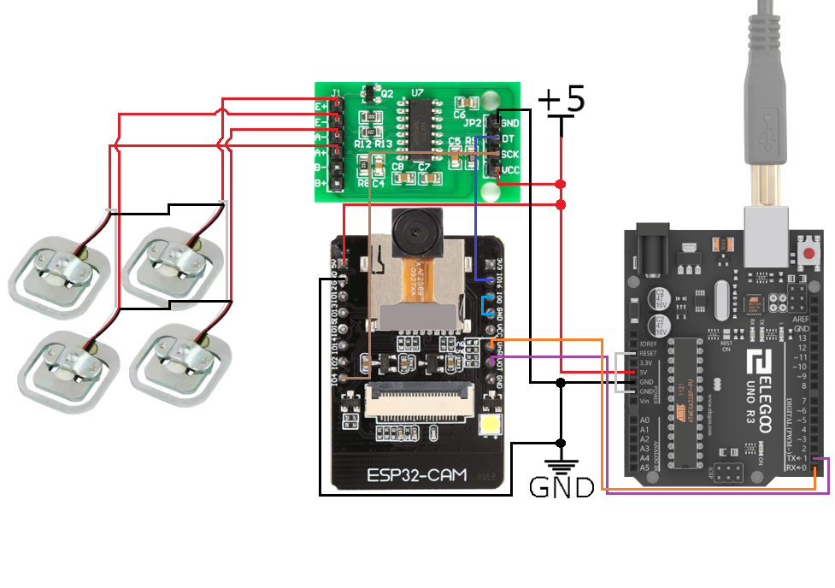
Achieved results
Second Idea

Slide 34
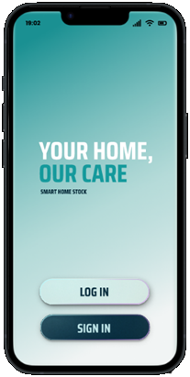
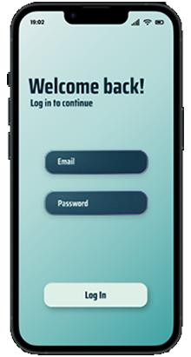
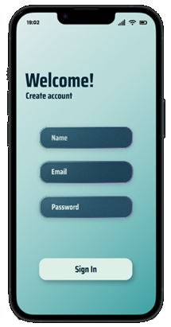
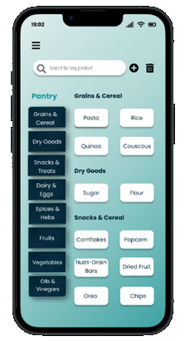
Achieved results
Figma application design:

Slide 35
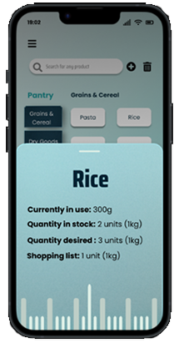
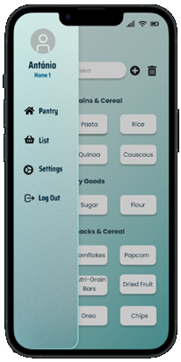
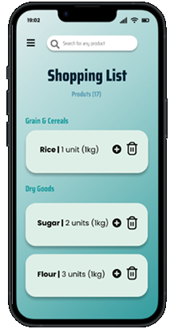
Achieved results
Figma application design:

Slide 36

CHALLENGES FACED BY THE TEAM

Slide 37
Challenges faced by the team
Price versus convenience in the first idea:
On one hand, there was fear in a product that might be too expensive for consumers.
On the other hand, finding a solution that allowed the use of a single scale for multiple containers reduced the automation and independence of the product.
Learning HTML and other programs.
Difficulty in calibrating the load cells.

Slide 38
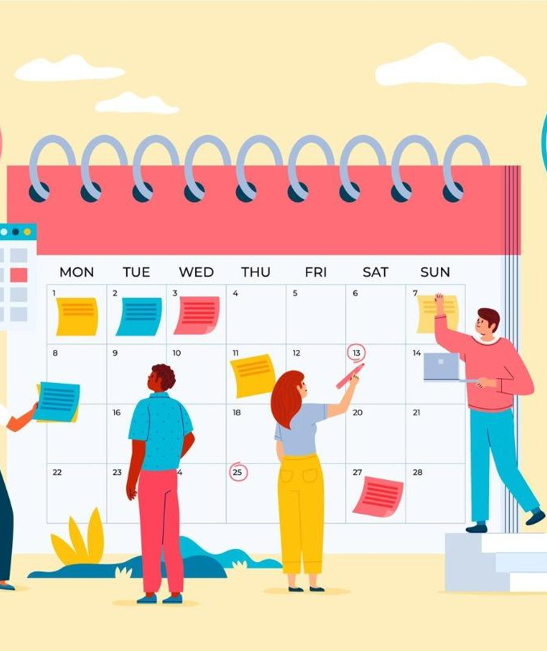
DEVIATIONS FROM ORIGINAL SCHEDULE

Slide 39
Deviations from original schedule
The main causes for our deviation from original schedule:
Unclear project scope and objectives;
Underestimation of task complexity;
Technical roadblocks and unforeseen issues;
Limited access to equipment, software or expertise;
Personal commitments and workload;

Slide 40

CONTRIBUTION OF EACH MEMBER

Slide 41
Contribution of each member
Prototype team
Ricardo Fiúza | Rafaela Pereira | Renato Simões
Prototype Modelling | Prototype Modelling | Prototype Modelling
Block diagram of hardware | Block diagram of hardware | Block diagram of hardware
Projection of the hardware part of the system | Projection of the hardware part of the system | Projection of the hardware part of the system

Slide 42
Contribution of each member
Software and design team
Vera Amaral | Henrique Simões | Leonor Mira
Web Development and Management | Web Development and Management | Web Development and Management
Figma application design | Figma application design | Figma application design
Figma website design | Figma website design | Figma website design

Slide 43

CORRECTED SCHEDULE

Slide 44
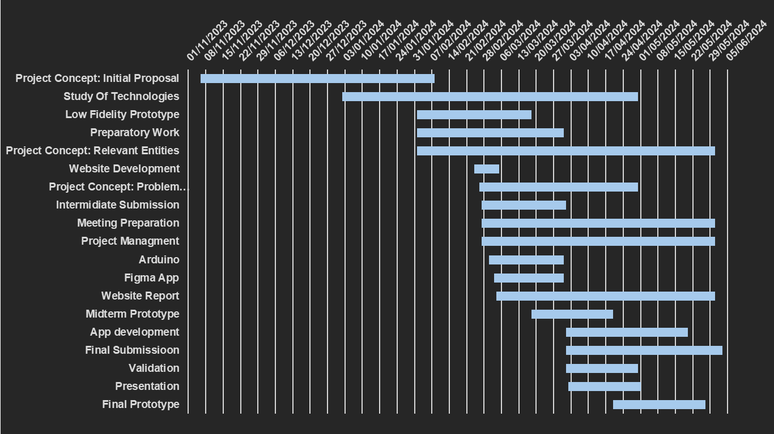
Corrected Schedule

Slide 45


Contact Information
smarthomestockshs@gmail.com

